Slide 1
Unit -4
Basics of React
And
Functional Programming with JavaScript

Slide 2
Welcome to React
React is a popular library used to create user interfaces.
It was built at Facebook to address some of the challenges associated with large-scale, data-driven websites.
React was released in 2013
React are quite unique.
In React, you write code that looks like HTML right in your JavaScript
The library is used for web app development and is designed to help developers create fast single-page applications and user interfaces.

Slide 3
Obstacles and Roadblocks
React Is a Library
React library is small and it is only used for one part of the job.
There are so many different library names continually being added to the discussion that it may feel like it’s impossible to keep up.
Popularity of Functional JavaScript
In addition to the changes emerging at a language level
JavaScript isn’t necessarily a functional language, but functional techniques can be used in JavaScript code.
React emphasizes functional programming over object-oriented programming. This shift in thinking can lead to benefits in areas like testability and performance

Slide 4
React’s Future
ReactJS, has a lot to offer, making it the first choice for web development.
ReactJS for their project’s front-end requirements over other libraries.
JavaScript is the programming language of the web. ReactJS is one of the best frameworks that enable the creation of user interfaces and other programs for web applications through JavaScript.
ReactJS is a resourceful technology that lets you innovate various app solutions, including Dashboards, Social Networks, eCommerce platforms, Marketplaces, and many more
Excellent Choice for Single Page Apps

Slide 5
Cont..
ReactJS has overtaken jQuery and become the most used web framework by software developers worldwide as of 2021.
ReactJS is the most popular front-end framework/library of 2021.
Facebook and communities of developers worldwide maintain ReactJS, and many forums are there with thousands of React users helping each other with best practices, contributing to the library’s future.

Slide 6
Keeping Up with the Changes
As changes are made to React and related tools, sometimes there are breaking changes. In fact, some of the future versions of these tools may break some of the example code in this book.
You can still follow along with the code samples. We’ll provide exact version information in the package.json file, so that you can install these packages at the correct version

Slide 7
Working with the Files
File Repository
The GitHub repository associated with this book provides all of the code files organized by chapter
React Developer Tools
There are several developer tools that can be installed as browser extensions or add-ons that you may find useful as well:
react-detector
react-detector is a Chrome extension that lets you know which websites are using React and which are not.
show-me-the-react
This is another tool, available for Firefox and Chrome, that detects React as you browse the internet.
React Developer Tools
This is a plugin that can extend the functionality of the browser’s developer tools.
Installing Node.js
Node.js is JavaScript without the browser. It is a runtime environment used to build full-stack JavaScript applications. Node is open source and can be installed on Windows, macOS, Linux, and other platforms

Slide 8
Class
A class is the blue print or template from which individual objects are created.
Class is a special kind of function.
Class declaration
Class calling

Slide 9
Define a class
1st way:
with the help of class keyword.
class class_nane
{
// class body with constructor
}
Example: class Car {
constructor(name, year) {
this.name = name;
this.year = year;
var1=this.name;
var2=this.year;
}
}

Slide 10
2nd way to define the class
Var class_name=class classname{
//body of the constructor
}
Example :
var car=class car{
constructor(name, year) {
this.name = name;
this.year = year;
var1=this.name;
var2=this.year;
}
}

Slide 11
Class calling
Create object
Const object_name=new class_name(argument list);
Example: const myCar = new car("Ford", 2023);

Slide 12
Arrow functions
There’s another very simple and concise syntax for creating functions, that’s often better than Function Expressions.
It’s called “arrow functions”, because it looks like this:
let func = function(arg1, arg2, ..., argN) { return expression; };
let sum = function(a, b) { return a + b; };
let func = (arg1, arg2, ..., argN) => expression;
let sum = (a, b) => a + b;
alert( sum(1, 2) );

Slide 13
Transpilers
};
A transpiler is a special piece of software that translates source code to another source code. It can parse (“read and understand”) modern code and rewrite it using older syntax constructs, so that it’ll also work in outdated engines.
Example:
const fun = (x) => {x*2};
Will be converted to following code
var fun = function fun(x) {
x * 2;

Slide 14
Array
An array declaration allocates sequential memory blocks.
Arrays are static. This means that an array once initialized cannot be resized.
Each memory block represents an array element.
Array elements are identified by a unique integer called as the subscript/index of the element.
Arrays too, like variables, should be declared before they are used.
Array initialization refers to populating the array elements.
Array element values can be updated or modified but cannot be deleted.

Slide 15
Cont..
Declaring and Initializing Arrays
var array_name; //declaration
array_name = [val1,val2,valn..] //initialization
OR
var array_name = [val1,val2…valn]
Accessing Array Elements
Array Object
An array can also be created using the Array object. The Array constructor can be passed as −
A numeric value that represents the size of the array or.
A list of comma separated values.
var arr_names = new Array(4)
var names = new Array("Mary","Tom","Jack","Jill")

Slide 16
Array Methods
1 | concat()Returns a new array comprised of this array joined with other array(s) and/or value(s)
2 | indexOf()Returns the first (least) index of an element within the array equal to the specified value, or -1 if none is found. array.indexOf(searchElement[, fromIndex]);
3 | join()Joins all elements of an array into a string. var str = arr.join(" + "); console.log("str : " + str );
4 | pop() method removes the last element from an array and returns that element var numbers = [1, 4, 9]; var element = numbers.pop(); console.log("element is : " + element );

Slide 17
Cont..
push() method appends the given element(s) in the last of the array and returns the length of the new array.
var numbers = new Array(1, 4, 9); var length = numbers.push(10);
reverse() method reverses the element of an array. The first array element becomes the last and the last becomes the first.
var arr = [0, 1, 2, 3].reverse();
slice() method extracts a section of an array and returns a new array.
Syntax
array.slice( begin [,end] );
sort() method sorts the elements of an array.
var arr = new Array("orange", "mango", "banana", "sugar");
var sorted = arr.sort();

Slide 18
ES6 - Objects
JavaScript objects are a great way to define custom data types.
An object is an instance which contains a set of key value pairs.
But array was using the scalar index values but we can give here any name of index.
Syntax: let object_name={
Key : value,
<key : value >,…};
example: let student={
name: 'Ram',
age:23,
course: 'MCA’}

Slide 19
Cont..
Change the value of object’s element
Syntax: objectName.element=value;
student.age=40;
Delete an element of an object
delete object.element;
delete student.age;

Slide 20
Creating array within object
let student={
name: 'Ram',
age:23,
course: 'MCA',
subject: ["english","science","math"]// array within a object };
Access the value of array which is in object
objectName.arrayName[index number];
Example: student.subject[2];

Slide 21
Common js
The CommonJS module proposal specifies a simple API for declaring modules that work outside of the browser (such as on the server).
a CommonJS module is a reusable piece of JavaScript that exports specific objects made available to any dependent code.
CommonJS modules basically contain two primary parts: a free variable named exports, which contains the objects a module wishes to make available to other modules
// package/lib is a dependency we require var lib = require( "package/lib" );
// behaviour for our module function foo(){ lib.log( "hello world!" ); }
// export (expose) foo to other modules exports.foo = foo;

Slide 22
Module
In javascript, Module is a javascript file where we write the code.
The object in a module are not available for use, unless the module file exports them.
Modules are imported with the help of import statement to use module in any file.
To run this we need a live server for example xampp.

Slide 23
Exporting a Module
Named Exports
Default Exports

Slide 24
Named exports (using multiple export keyword )
Named exports are distinguished by their names. There can be several named exports in a module.
Syntax:
//using multiple export keyword
export component1
export component2
......
export component
Example:
export name=“abc”;
export class hello{
}

Slide 25
Named exports (using single export keyword)
Syantax:
export {component1,component2,....,componentN}
Example: export {name,hello}

Slide 26
Default Exports
Modules that need to export only a single value can use default exports. There can be only one default export per module.
Syntax:
export default component_name;
Example:
export default name;

Slide 27
Importing a Module
To be able to consume a module, use the import keyword. A module can have multiple import statements.
Syntax:
import {component1,component2..componentN} from module_name
Example:
import {name,hello} from ‘./module.js’;

Slide 28
Example:
Export file
let company = “file"
let getCompany = function()
{ return company.toUpperCase() }
let setCompany = function(newValue)
{ company = newValue }
export {company,getCompany,setCompany}
Import file
import {company,getCompany} from './company1.js’
console.log(company)
console.log(getCompany())

Slide 29
Imperative vs Declarative
Declarative style it means developer write how it should be, not how to do.
Imperative style developer write how to do, in the imperative style developer define the task step by step.
Better choice is to use the code in the declarative style because simplicity is always better.
Simplicity is closely related to Keep it simple stupid.

Slide 30
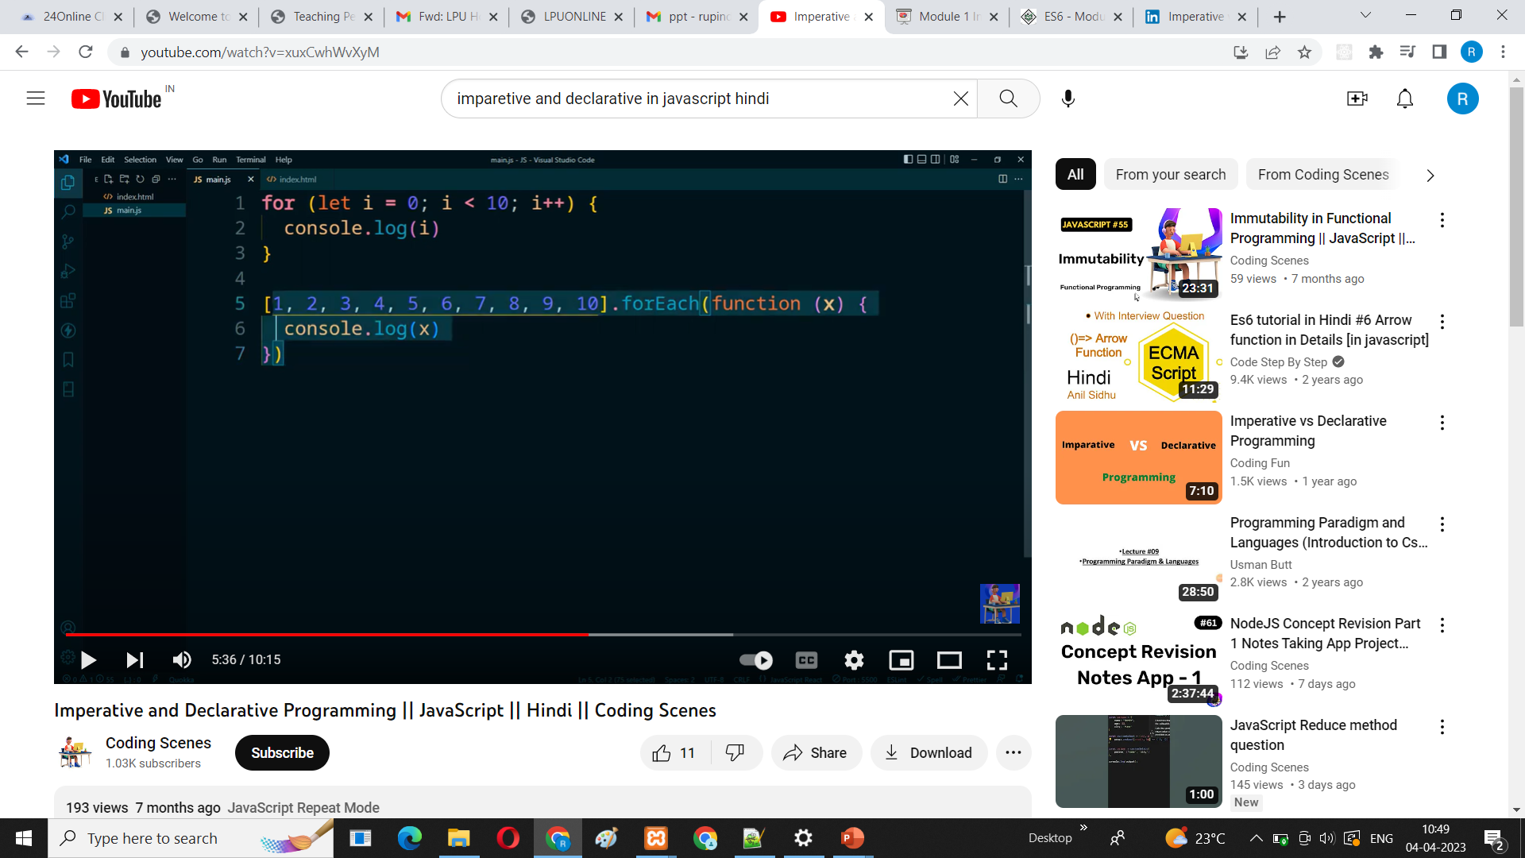

Imperative
Declarative

Slide 31
Functional Concepts
Immutability In a functional program, data is immutable. It never changes.
Pure Functions
A pure function is a function that returns a value that’s computed based on its arguments.
Pure functions take at least one argument and always return a value or another function.
The function should not change or mutate any of its arguments.
Data Transformations Functional programming is all about transforming data from one form to another. We’ll produce transformed copies using functions. These functions make our code less imperative and thus reduce complexity
Higher-Order Functions
Higher-order functions are functions that can manipulate other functions. They can take functions in as arguments or return functions or both.
The first category of higher-order functions are functions that expect other functions as arguments
Recursion
Recursion is a technique that involves creating functions that recall themselves.

Slide 32
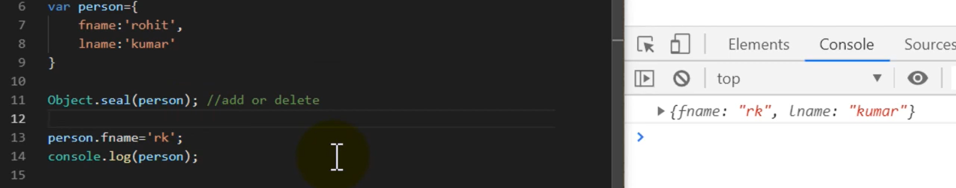
Immutability
With seal() new data will not be entered but updating is possible.
With freeze() updating is not possible

Slide 33
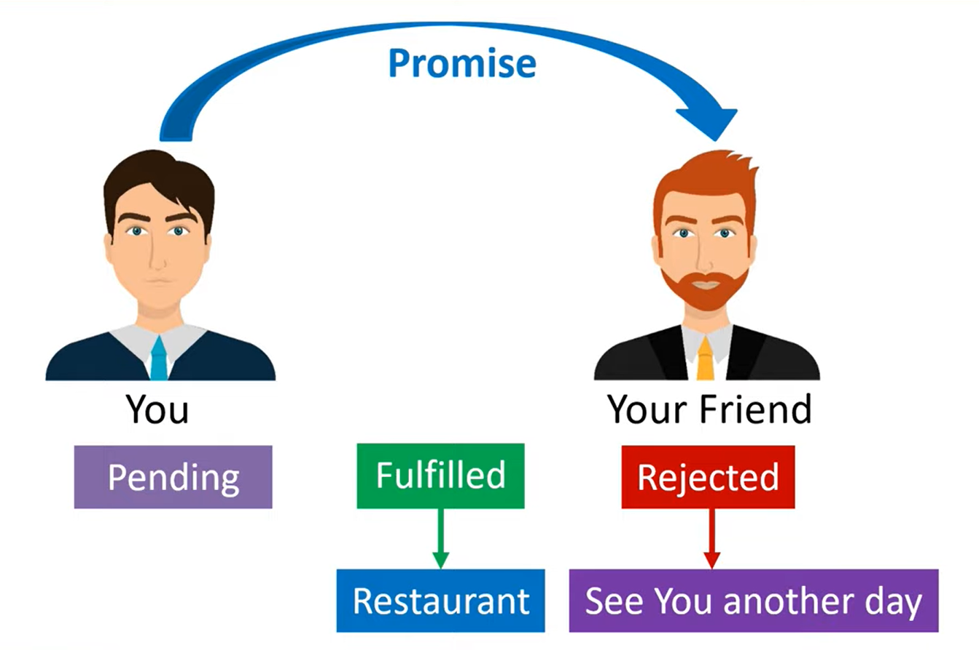
ES6- Promises
While a Promise object is "pending" (working), the result is undefined.
When a Promise object is "fulfilled", the result is a value.
When a Promise object is "rejected", the result is an error object.
To go to Restaurant or not it totally depend on the result of the promise

Slide 34
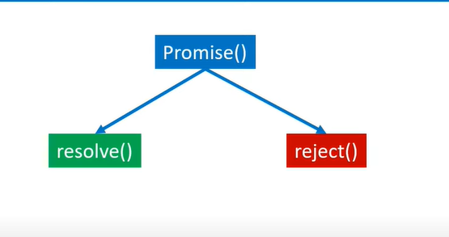
ES6- What is Promise ?
Similarly, The promise is a method which depends on the conditions.
Two outcomes will be there, if the condition is fulfilled means it get resolve or it get rejected.

Slide 35
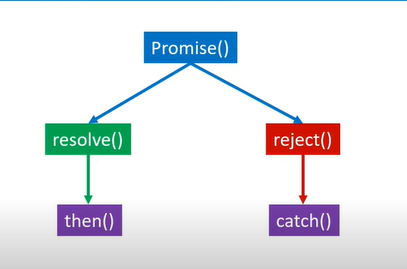
ES6- What is Promise ?
If the condition is resolve then the JavaScript then() method could be applied further that indicate what need to do (if two friends are meeting they will go to Restaurant).
If condition got rejected then in the catch() method will be applied.
Both then and catch are basically the call back function (inbuild function of JavaScript). Callback function which is used to call another function.
Resolve and reject are user defined function can give any name to it.

Slide 36
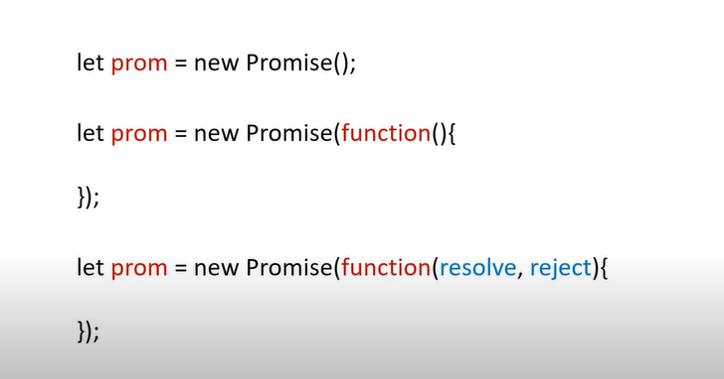
Promise Syntax-
Promise’s object is created
Promise’s function is created
Parameterised Promise function created which having resolve and reject (name any can be given)

Slide 37
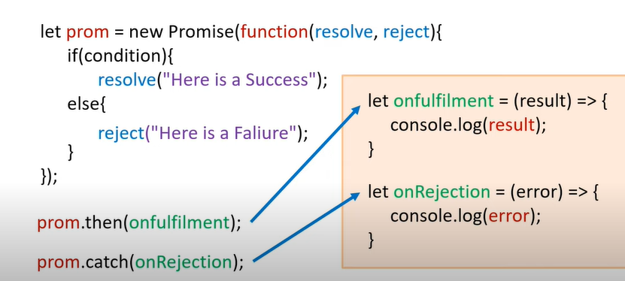


Promise Syntax-

